Slide 1
Reasoning Based Context Aware Action Sequence Prediction Using Large Action Model
Anany Prem
(IISc, DSBA-2023)
Mid-term Review
323000109
Internal Company Guide: Sourabh Tiwari
IISc Faculty Mentor: Yogesh Simmhan

Slide 2
Problem Description
Challenges:
In modern era user has multiple smart devices such as TV, AC, Washing machine etc. in home. User uses natural voice commands to control, get status, set routines on these devices.
Understanding the user’s command to detect the intention and slots, is important NLU (Natural Language Understanding) research field.
Conventional Deep Learning models are good in Intent and slot prediction, but they can not understand the contextual information, such as device’s state (on/off), current mode, disambiguation resolution for multiple possible devices etc.
Advantages of LLM’s is that they are designed to answer user queries, by understanding the home context as input. Variation of LLM’s can predict the function/API to be called to handle user’s command, but they cannot think and act as human do.
Proposed Solution:
The project aims to develop “Reasoning based context aware action sequence prediction” and utilize LLM capability for reasoning and understanding context to provide optimal action sequences.
Utilize neuro-symbolic AI for dynamic action sequence prediction.

Slide 3
Motivation
Enhancing User experience and Broader Impact :
AI is evolving, and smarter automation is required for seamless user experience.
Samsung R&D Institute-Bangalore is working on solving the Large Action Model problem.
This project contributes to improving action sequence prediction using context-aware AI.
Real Life Analogy ( How Human performs the task ) :
Key Concept: Humans naturally skip unnecessary steps when performing a task.
Example: Watching IPL on TV
Step 1: Enter the living room
Step 2: Turn on the TV (if OFF)
Step 3: Set the channel (if needed)
Step 4: Adjust the volume (if required)
Step 5: Start watching
If some actions (TV ON, correct channel) are already done, we skip those steps.
AI in NLP: Applying This Concept to Voice Assistants
The same logic should apply to voice assistants like Bixby.
Instead of executing a fixed set of commands, AI should:
Understand the current context
Predict only the required actions
Optimize smart home control for better user experience

Slide 4
Execution Types
S No | Execution Type | Example Command | Intention
1 | Single Device Execution | Turn on the living room TV. | TV: Turn on
2 | Multiple Device Execution | Set the AC temperature to 22 degrees and close the blinds. | AC: Set temperature to 22 degrees Blind: Close
3 | Implicit Single Device Execution | It’s very cold in bedroom. | AC: Set temperature to 24 degrees.
4 | Implicit Multiple Device Execution | Set ambience for office meeting. | TV: Turn off. AC: Set to wind free mode. Light: Set lighting mode as reading. Vacuum Cleaner: Pause cleaning.

Slide 5
Categories
S No | Category | Precondition | Command | Intention
1 | Ambience Control | 1 Living room TV is on, 1 Living room Speaker is on, 1 Living room RVC is on 1 light is on | Silence the room | Living room TV: Mute Living room Speaker: Mute Living room RVC: Pause cleaning
2 | Ambience Creation | 1 AC is on, 1 TV is on, 1 RVC is on | Set up this room for candle light dinner with wife | AC: Set temperature to 22 degrees TV: Play romantic music in YouTube RVC: Pause the cleaning
3 | Complementary Experience | 1 Living room fan is on, 1 RVC is turned off | Start cleaning the living room | Living room Fan: Turn off RVC: Clean the living room
 |  | 1 Living room AC is off, 1 Living room blinds are on | It’s getting hot in here, do something | Living room AC: Turn on Living room Blind: Turn off
4 | Home Routine | 1 Living room AC is on | Make it cool automatically when it’s hot | Living room AC: Set AC temperature to 22 degrees when room temperature goes above 24 degrees
5 | Conditional Command | 2 Lights in Bedroom, 1 Light in living room, 1 light in kitchen | Turn off all the lights except kitchen | Bedroom Lights: Turn off Living room Light: Turn off
 |  | 1 Kitchen fan is off, 1 Kitchen chimney is off | Turn on the fan after turning on the kitchen chimney | Kitchen Chimney: Turn on Kitchen fan: Turn on

Slide 6













Proposed Solution
Home Context
HLAM
(Home Large
Action Model)
Input
SmartThings Devices
Action Sequence
Device Control
API
Prompt user
For disambiguation
NLG
Output
Considers Home Context (Location, Room, Device Names, Device States)
Predicts action sequence (thinks and acts as human)
Prompt user for disambiguation
Use device control API from SmartThings to control devices

Slide 7
Proposed Solution
Home Dataset
Home Template based data creation
Device Identification, Disambiguation
Situation based device identification
Reasoning based Plan & Execution
Deep reasoning and planning with context & personalization
Neuro Symbolic AI
Fine tune with minimal training data, Dynamic predictions

Slide 8
HLAM Capabilities
Classification & Inferencing
Home Device & Services Knowledge Graph
Device Identification/
Disambiguation
User Home & Devices Context
Action Planning & Reasoning
Scenario Specific Outputs
Prompt
Constructor
User Preferences & Usage Patterns
Multi Turn Conversation
External Context (Time, Weather, Location, Surrounding)
Action
Execution
Create Routine
Generate Ambience
Complex Actions
Generate Summary
Q&A
Suggest Actions

Slide 9

Use Case 1:
1
Play house of Ninjas on Living room TV
2
Finetuned Action Sequence Policy: Act as Human
identify_device(slot=Living room TV)
powerswitch_getsStatus(device=“TV_ID”)
device_turnOn(device=“TV_ID”)
find_appName(programName=“House of Ninjas”)
application_launch(appName=“Netflix”, programName=“House of Ninjas”)
generate_completion(execution_status=“status”)
HLAM
Context Data:
User’s IoT PDSS Data: Room, Devices, State etc.
CLS: Program Info, App info etc.
Action Sequence
Prediction
3
Context Aware HLAM Understanding:
Living room TV as device ID from IoT PDSS data
If not available: action handler will prompt user “which device?”
If available: HLAM pre-fill identify_device response as Device ID
Device status from IoT PDSS device state (On/Off)
If Off, this step will execute by action handler
If On, HLAM pre-fill device_turnOn result as true
Understands from CLS context, show is available in Netflix
5
Action Execution on TV
NLG Playback
6
Action 1 to N
4
Final Action Sequence from HLAM:
application_launch(device=“TV_ID”, appName=“Netflix”, programName=“House of Ninjas”)
generate_completion(execution_status=“status”)
Playing House of Ninjas on Living Room TV now. Enjoy.

Slide 10
Use Case 2:
1
Set cooking course for red sauce pasta
2
Finetuned Action Sequence Policy: Act as Human
identify_device(slot=“”)
powerswitch_getsStatus(device=“Microwave_ID”)
device_turnOn(device=“Microwave_ID”)
find_recipecourse(recipe=“red sauce pasta”)
set_cookingcourse(courseName=“eco convection”)
generate_completion(execution_status=“success”)
HLAM
Context Data:
User’s IoT PDSS Data: Room, Devices, State etc.
DA services: Recipe data
Context Aware HLAM Understanding:
Identify device ID from IoT PDSS data, user has not mentioned device name
If only 1 capable device: HLAM pre-fill identify_device response as Device ID
If multiple capable devices: Prompt user for which device he want to set course, list all devices.
Device status from IoT PDSS device state (On/Off)
If Off, this step will execute by action handler
If On, HLAM pre-fill device_turnOn result as true
Understands from recipe context, course name is eco convection.
Action Sequence
Prediction
3
Action Execution on Microwave
5
NLG Playback
6
Action 1 to N
Cooking course is set in the microwave for red sauce pasta
4
Final Action Sequence from HLAM:
set_cookingcourse(device=“Microwave_ID”,courseName=“eco convection”)
generate_completion(execution_status=“status”)

Slide 11
Conventional Action Model
Action Sequence to be followed by Machine:
S1. identify_device(slot=Living room TV)
S2. powerswitch_getStatus(device=“TV_ID”)
S3. device_turnOn(device=“TV_ID”)
S4. find_appName(programName=“House of Ninjas”)
S5. application_launch(appName=“Netflix”, programName=“House of Ninjas”)
S6. generate_completion(execution_status=“status”)
For any command, the machine can predict the action sequences.
Execution happens step by step.
Play house of Ninjas on Living room TV
Input Command
NLG Response
s1
s2
s3
s4
s5
s6
Identify_device
powerswitch_getstatus
Device_turnOn
Find_appName
Application_launch
Generate_completion
Case 1: TV was off, powerswitch_getstatus returned false.
Input Command
If Device is On
NLG Response
s1
s2
s3
s4
s5
s6
Identify_device
powerswitch_getstatus
Device_turnOn
Find_appName
Application_launch
Generate_completion
Case 2: TV was on, powerswitch_getstatus returned true.

Slide 12
HLAM with Neuro Symbolic AI: To understand Context as Human
Case 1: No Context Data Available. Follow Each Step.
Case 2:All Context Data Available, Jump to last step.
Action Sequence to be followed by Machine:
S1. identify_device(slot=Living room TV)
S2. powerswitch_getStatus(device=“TV_ID”)
S3. device_turnOn(device=“TV_ID”)
S4. find_appName(programName=“House of Ninjas”)
S5. application_launch(appName=“Netflix”, programName=“House of Ninjas”)
S6. generate_completion(execution_status=“status”)
Action Sequence to be followed by Machine:
S5. application_launch(appName=“Netflix”, programName=“House of Ninjas”)
S6. generate_completion(execution_status=“status”)
s1
s2
s3
s4
s5
s6
s5
s6
Case 3: Partial Data Available, TV is off, appName is known. Skip intermediate steps.
Case 4: Partial Data Available, 2 TV in living room, both are on. appName is known.
Action Sequence to be followed by Machine:
S3. device_turnOn(device=“TV_ID”)
S5. application_launch(appName=“Netflix”, programName=“House of Ninjas”)
S6. generate_completion(execution_status=“status”)
Action Sequence to be followed by Machine:
S1. identify_device(slot=Living room TV)
S5. application_launch(appName=“Netflix”, programName=“House of Ninjas”)
S6. generate_completion(execution_status=“status”)
s3
s5
s6
s1
s5
s6

Slide 13
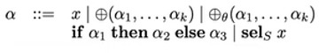
HLAM with Neuro Symbolic AI: To understand Context as Human
Simple Prompt Example:
Example: User asks you "Turn on the lights please."
You MUST respond with all the action sequences that are necessary in order to achieve the following steps given
in the <rules> tag below:
<rules>
S0: Start
S1: S0 ∧ slot='Light' -> identify_device
S2: S1 ∧ device_id='Light_ID' -> device_turnOn
S3: S2 ∧ status=success/fail -> generate_completion
S4: S3 ∧ END
</rules>
If you are able to skip any rules due to available context from the user, then comment it out using '//'.
State
Operation
Conditions
Symbolic Rule
Path Selection
Advantages:
Automate complex and situational human decision making.
Work with limited data
Ensure explainable, reliable and traceable decisions.
Leverages knowledge graphs, information for context; LLM for reasoning and decision making.

Slide 14
Flow Diagram
Context Data Services
User Command
Devices Control
NLG Playback
1
Context Providers
Action Handlers
Action Handler: Handlers to perform actions such as device disambiguation, device action etc.
List
2
3
7
Reasoning: Instructions for HLAM to decide action sequence
Reasoning Prompt
Final Response
to user
4
6
HLAM
Action Execution, Prompt
HLAM Actions: Think and act as human,
Divide task into sequence of actions
5
Sequence of Actions to be performed by different Action Handlers
Action 1 to N
Action: {Input, Reasoning State, Response State, Result}
It will prompt user if not getting sufficient results

Slide 15
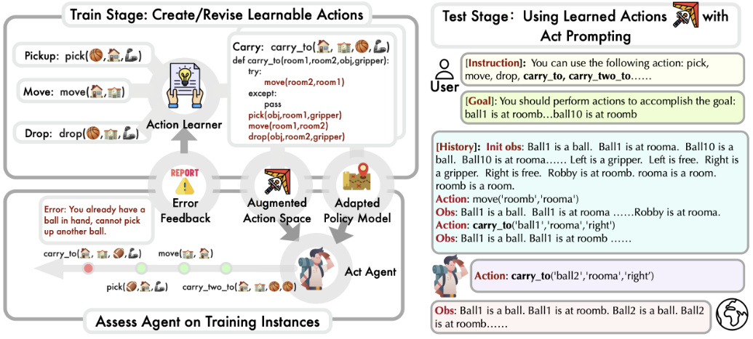
Prior Art
Overview: Empowering Large Language Model Agents through Action Learning
Paper: 2311.00772.pdf (arxiv.org)
Dataset: LearnAct/dataset at master · zhao-ht/LearnAct · GitHub
Github: https://github.com/zhao-ht/LearnAct
LLM/LAM: GPT4, GPT3.5
Pro’s:
Strong performance in robotic planning tasks considering reasoning through LLM.
Enables language agents to learn customized action space that better fits the LLM’s planning capacity.
Code is customizable to incorporate new datasets and LLM’s easily.
Issue’s:
Bixby HLAM actions representation in PDDL, ADL format (robotic planning format) is difficult.
Dialogs/Conversations are not considered.
Response or NLG is not considered.
Contextual input is not considered.

Slide 16
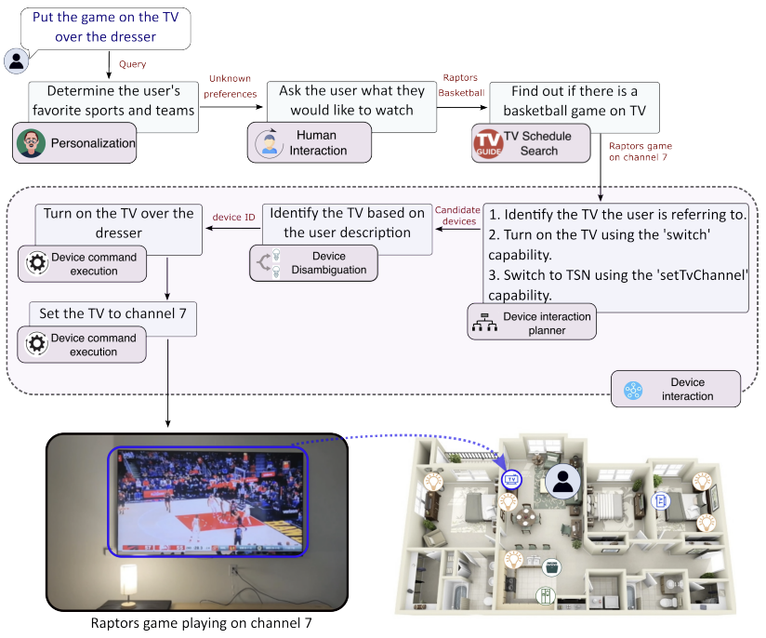
Prior Art
Overview: Smart Home Agent with Grounded Execution
Paper: 2311.00772.pdf (arxiv.org)
Dataset: NA
Github: NA
LLM/LAM: GPT4, GPT3.5, Lemur, Claude
Pro’s:
Samsung AI Centre, Montreal’s paper.
Agentic approach, Each agent can have one or more actions.
Multi-modal support for device disambiguation.
Fine tuned to support reasoning and dialogs/conversation.
Use both open source and close source LLM’s for verification.
Issue’s:
Dataset used, Github code, fine-tuned model is not available.
Verified on very small test dataset.
Context source and End execution steps are not clear.
Context as input using prompt and RAG is not considered.

Slide 17
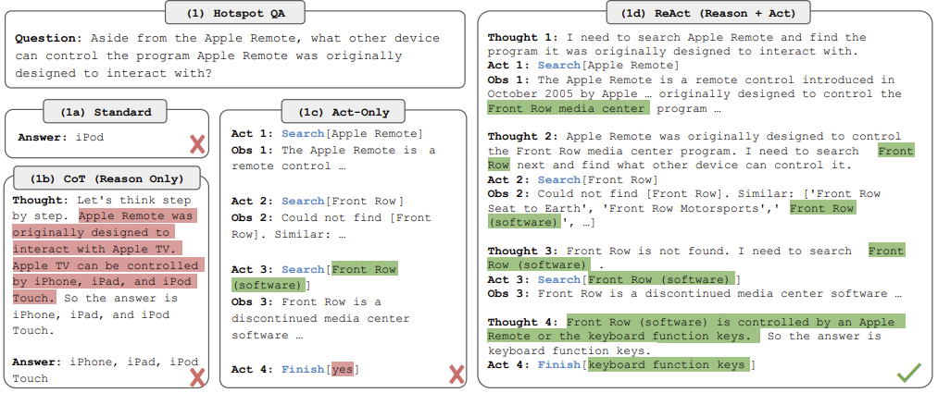
Prior Art
Overview: Synergizing Reasoning and Acting in Language Models
Paper: 2210.03629.pdf (arxiv.org)
Dataset: NA
Github: NA
LLM/LAM: Palm 540B
Pro’s:
ReAct framework to provide reasoning and acting sense to LLM responses.
Able to reason out complex NL inputs.
Generates action sequence in NL format.
ReAct as framework can be used to enhance HLAM fine-tuning and prompt design.
Issue’s:
Generate actions with reasoning in NL format so can not be used directly for action execution.
Dialog and conversations performance needs to be evaluated.

Slide 18
Data
Utterance
Home Context
Environment Context
Prediction
Category | Training Data | Test Data
Explicit | 1000 | 200
Ambience Control | 200 | 40
Ambience Creation | 200 | 40

Slide 19
Experiments
LLM | 0 Shot | 1 shot | Few (3) shot | Finetuned | Distillation
Mistral 7B | Done | Done | Done | Done | TBD
Phi-4 14B | Done | Done | Done | Done | TBD
Gemini 2.0 | Done | Done | Done | NA | NA
Chat-GPT 4o | Done | Done | Done | NA | NA

Slide 20
Experimental Results
LLM | 0 Shot | 1 shot | Few (3) shot | Finetuned | Distillation
Mistral 7B | 147/280 | 188/280 | 201/280 | 223/280 | TBD
Phi-4 14B | 176/280 | 209/280 | 214/280 | 235/280 | TBD
Gemini 2.0 | 206/280 | 247/280 | 267/280 | NA | NA
Chat-GPT 4o | 198/280 | 245/280 | 262/280 | NA | NA

Slide 21
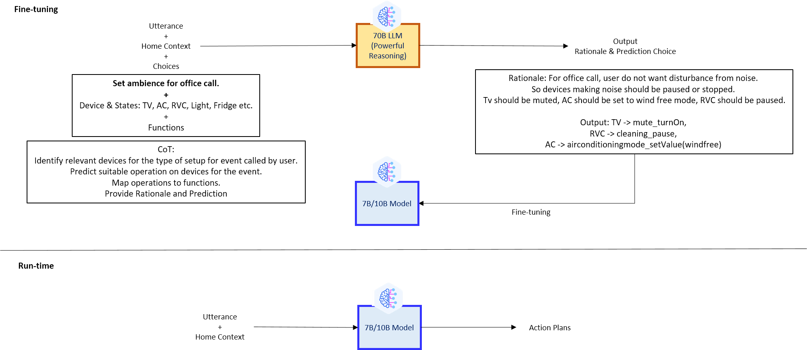
Distillation (TBD)

Slide 22
Future Work (May - July)
Distillation based Fine tuning and performance evaluation.
Consider Llama, Qwen models for evaluation and performance comparison.
Consider remaining 3 categories, Complimentary Experience, Home routine and Conditional commands.
Publication.

Slide 23
Conclusion

Slide 24
Anany Prem
IISc, DSBA - 2023

